Slide 1
Cover slide
Name
Institution
Course
Instructor
Date

Slide 2
proposal
Energy efficiency for hospital buildings.
Notes:
The proposal is to attain sustainable energy efficiency methods for hospital buildings.

Slide 3
Energy factors
Building
Energy savers
change of systems
Notes:
Various factors influence the use of energy in hospital buildings. These factors include the design of the buildings for efficient use of energy.
The use of energy in the building also requires use of energy saving mechanisms. The old systems compared to use of new systems also influence the use of energy.

Slide 4
Energy use
Cooling
Air conditioning
Heating
Lighting
Sterilization
Notes:
There are various uses of energy in hospital buildings. Such include environmental cooling as well as air conditioning. Hospitals also require energy for heating. Improving environmental conditions within the hospitals is important. The lighting is responsible for most of the energy consumed in hospitals. Sterilization of equipement may also require energy.

Slide 5
Costs
Building renovations
Translucent roofs
  Natural lighting
Notes:
Various costs are associated with energy efficiency initiative. One includes renovating the buildings. The buildings should be built to allow free circulation of air. Translucent roofs can allow the buildings to use natural lighting during the day.

Slide 6
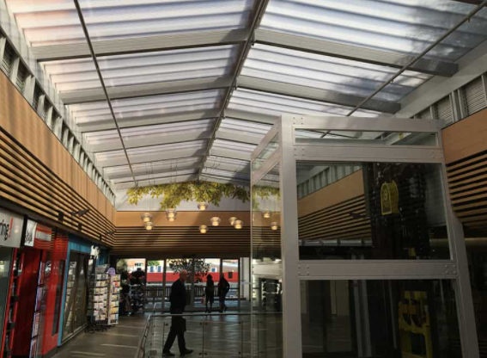
Translucent roofing
Notes:
Translucent roofing allows use of natural light during the day.

Slide 7
cost
Energy saving bulbs
LED bulbs
Notes:
The old lighting systems should be replaced with energy saving systems. lighting is a major factor in hospital buildings but also accounts for major consumption of energy. Light emitting diode(LED) bulbs help in reducing energy consumption.

Slide 8

LED BULBSE

Slide 9
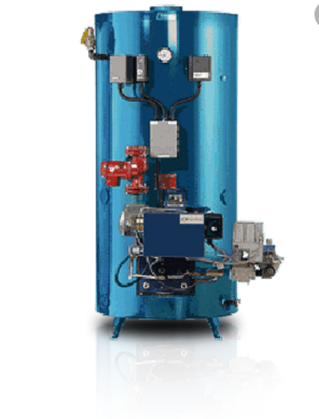
Costs
Use boiler systems for heating.
Notes:
The use of boiler systems can reduce the amount of energy required for heating in the hospitals.

Slide 10
Natural energy
Natural solar energy
Use solar panels
Notes:
Use of natural energy requires the use of solar panels to harness solar energy.

Slide 11
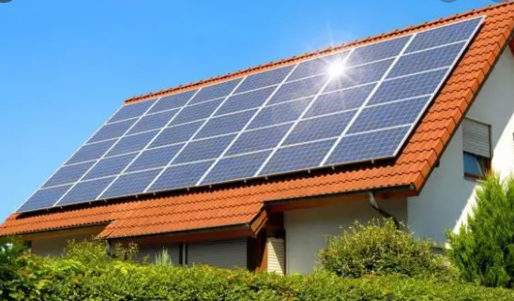
Solar panels
Notes:
Solar panels can provide the energy required for normal hospital operations. It is a great alternative to electricity.

Slide 12
Benefits
Low operational costs
Efficient service delivery
Notes:
Energy efficiency reduces the cost of energy by a great margin. This can be reflected in a reduced cost of operations. Energy efficiency also ensures constant supply of energy which improves the delivery of services within the hospital.

Slide 13
benefits: Cont.’
Environmental protection
  Use of clean energy
Notes:
Energy efficiency also protects environmental sustainability. Use of generators is a major source of environmental pollution. Use of solar energy can reduce the need fuels which lead to pollution.

Slide 14
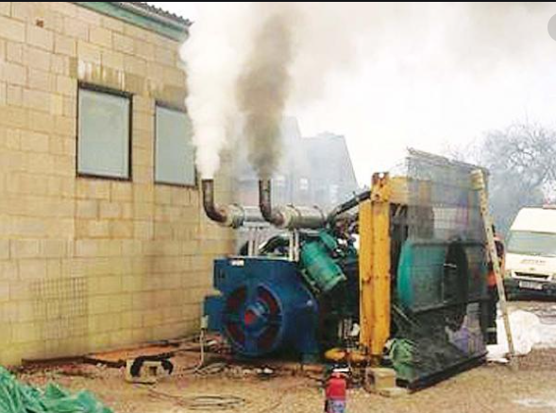
Unclean energy
Notes:
Back up fuel generators in hospitals are a major source of pollution. Solar energy provides an alternative for the use of fuel.

Slide 15
Benefits
Better hospital environment
  Better patient environment
Notes:
Use of energy efficient methods improves the hospital environment. The energy efficient building designs ensure the free flow of natural air in the buildings making it a better for the patients.

Slide 16
Benefits
Increased resources
  Better operations in other sectors
Notes:
Energy efficiency reduces the cost incurred in meeting the energy demand. These resources can be allocated in other areas to improve the efficiency of operations.

Slide 17
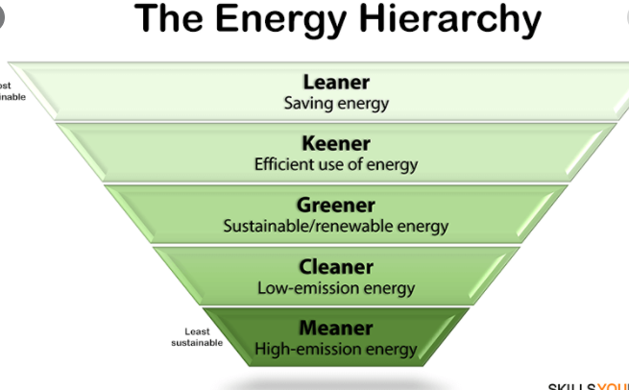
Energy efficiency

Slide 18
Patient care outcomes
Operational consistency
Resource availability
Operational efficiency
Notes:
Energy efficiency promotes operational consistency by providing consistent energy required for 24 hour operations within the hospital. It also reduces the cost of operations vailing more resources for other sectors in the hospital. There is also efficiency in operations due to availability of energy for all operations.

Slide 19
Waste reduction
Reduces use of fuels;
  Petrol & diesel
Notes:
Use of energy efficiency methods in hospitals reduces the need for back up generators. The generators emit pollutant gases to the environment.

Slide 20
Waste reduction
Low heat emission
  Old heating systems
Notes:
The use of energy efficient methods requires the replacement of old systems with new ones. The efficiency systems reduce the emission of excess heat which can be released to the environment as waste.

Slide 21
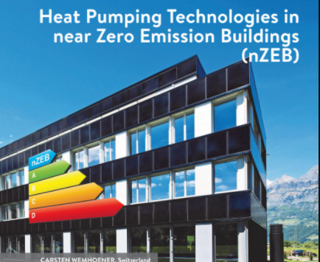
Waste reduction

Slide 22
Heat reflectors
Reflection of excess heat
  Cooler environment
Notes:
Use of heat reflective materials reduces the amount of environmental heat entering the building. This can reduce the excess heating inside the hospital buildings.it provides cooler environmental conditions within the hospitals.

Slide 23
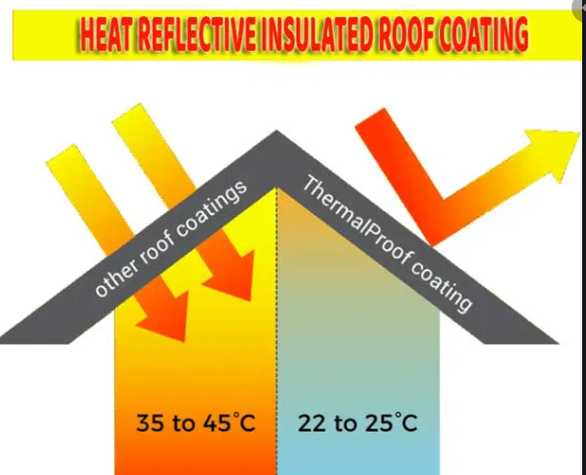
Thermal reflection

Slide 24
Community suggestions
Energy efficiency awareness
  Seminars,
  Brochures
Notes:
The community would need to be educated on the importance of energy efficiency. The community also needs to understand ways of achieving efficiency. This awareness can be created through many methods including seminars as well as distribution of educational brochures in the society.

Slide 25
Community education
Community educators
Community leaders
Energy organizations
Notes:
The community leaders need to partner with the community educators in identifying the main energy issues in the community. This way, they can identify the solutions to these methods as well as link them to organizations which deal with lack of energy efficiency.

Slide 26
Petition
Proper resource allocation for the initiative.
Notes:
Proper resource allocation by the community leaders can help in providing resources for enacting the initiative. The leaders need to understand the advantages associated with energy efficiency by implementing and allocating resources for this initiative. Energy efficiency also helps towards the achievement of the sustainable development goals.

Slide 27
References
Lam, J. C., Wan, K. K., Tsang, C. L., & Yang, L. (2019). Building energy efficiency in different climates. Energy Conversion and Management, 49(8), 2354-2366.
Patterson, M. G. (2016). What is energy efficiency?: Concepts, indicators and methodological issues. Energy policy, 24(5), 377-390.
Sorrell, S., & O’Malley, E. (2018). The economics of energy efficiency. Books.

